Slide 1
Computer Organization Final Project
Team 19: “Coder? I Hardly Know Her!”

Slide 2
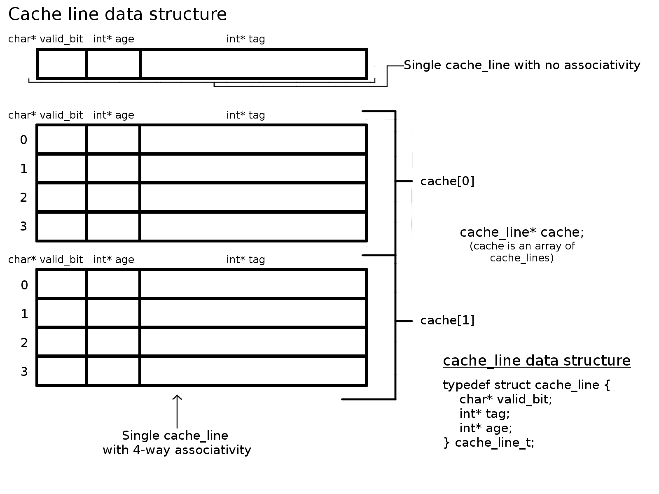
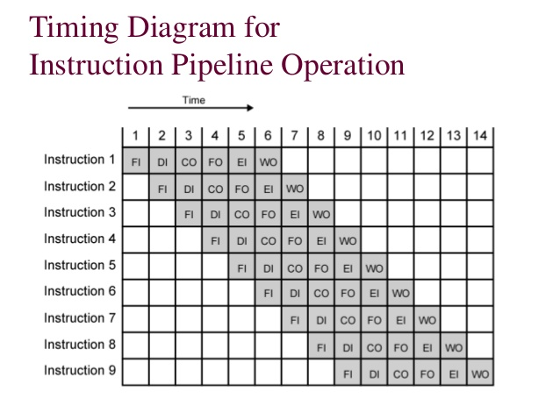
The Code
The cache stores the tags of addresses in an array of lines that is split up into blocks. Each line contains the valid bit, the age, and the tag for that address.
The analysis runs the IPLC 18 times with 9 different configurations, each run once with branch configuration TAKEN and once with NOT TAKEN.
The pipeline processes instructions concurrently, stalling when output from previous instructions is necessary.

Slide 3
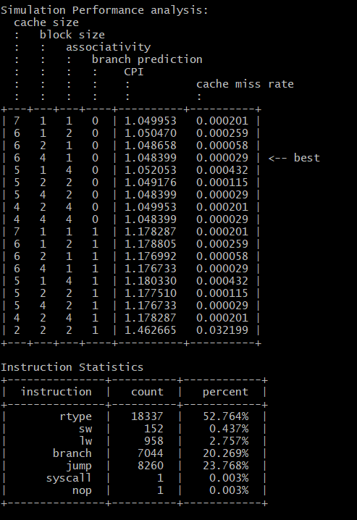
The Results
We tested cache sizes ranging from 2 through 7, block sizes ranging 1,2 and 4, associativity 1,2, and 4, and branch prediction configured TAKEN and NOT TAKEN.
The branch prediction configured NOT TAKEN was far faster because conditionals more frequently evaluate to false.
The best performance was found with the configurations (6,4,1,0) and (4,4,4,0).
The most common instruction was rtypes, taking up 52.764% of instructions. Jump and branch are far behind them with 20.269% and 23.768% respectively. Sw, Lw, Syscall, and Nop are far behind them with 0.437%, 2.757%, 0.003%, and 0.003% respectively.

Slide 4
The Team
Manager : Richard Massimilla
Cache Coder : Hunter Rouillard
Cache Documenter : Sam Fite
Pipeline Coder : Andrew Conley
Pipeline Documenter : Lucas Sheldon
Evaluation Coder : Scott Thiel
Evaluation Documenter : Julian Cohn

